Slide 1
DFT and FFT

Slide 2
Definition of Fourier Transform
http://en.wikipedia.org/wiki/Fourier_transform
We will be interested in the special case when functions are polynomials, i.e., Discrete Fourier Transform

Slide 3
Fast Fourier Transform: Applications
Applications.
  Optics, acoustics, quantum physics, telecommunications, control systems, signal processing, speech recognition, data compression, image processing.
  DVD, JPEG, MP3, MRI, CAT scan.
  Numerical solutions to Poisson's equation used in physics simulations.
The FFT is one of the truly great computational developments of this [20th] century. It has changed the face of science and engineering so much that it is not an exaggeration to say that life as we know it would be very different without the FFT. -Charles van Loan
Notes:
Significance. Perhaps single algorithmic discovery that has had the greatest practical impact in history. Progress in these areas limited by lack of fast algorithms. Variants of FFT used for JPEG, e.g., fast sine/cosine transforms

Slide 4
Fast Fourier Transform: Brief History
Cooley-Tukey (1965). Idea came from application of monitoring nuclear tests in Soviet Union and tracking submarines. Independently rediscovered CF Gauss divide-and-conquer approach, popularized use FFT.
CF Gauss (1805, 1866). Analyzed periodic motion of asteroid Ceres.
Importance of FFT not fully realized until advent of fast digital computers, and is still growing. There are several distinct FFT methods, but we focus on Cooley-Tukey divide-and-conquer method applied to multiplying polynomials.
FFT and WW3: There is speculation that FFT was responsible for saving the world during Cuban Missile Crisis 1963. FFT quickly distinguished a small earthquake in Cuba from Soviet missile launch.
Notes:
Gauss' algorithm published posthumously in 1866

Slide 5


Polynomials: Coefficient Representation
Polynomial. [coefficient representation]
Add: O(n) arithmetic operations.
Evaluate: Easy to see how to evaluate A(x) using 2n-2 multiplies. But, better using Horner's method using n-1 multiplies
Notes:
can also multiply in O(n^1.585) using Karatsuba polynomial multiplication

Slide 6
Polynomials: Point-Value Representation
Fundamental theorem of algebra. [Gauss, PhD thesis] A degree n polynomial with real or complex coefficients has n complex roots.
Corollary. A degree n-1 polynomial A(x) is uniquely specified by its evaluation at n distinct values of x.
y
y_{j} = A(x_{j})
x_{j}
x
Notes:
deep theorem - proof requires analysis
conjectures in 17th century, but not rigorously proved until Gauss' phd thesis
established imaginary numbers as fundamental mathematical objects

Slide 7
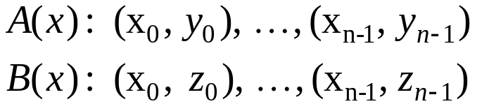
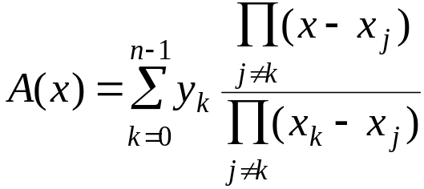
Polynomials: Point-Value Representation
Polynomial. [point-value representation]
Add: O(n) arithmetic operations.
Multiply: O(n), but need 2n-1 points.
Evaluate: O(n²) using Lagrange form for the unique polynomial given n points.
Caveat: Lagrange's form is numerically unstable

Slide 8
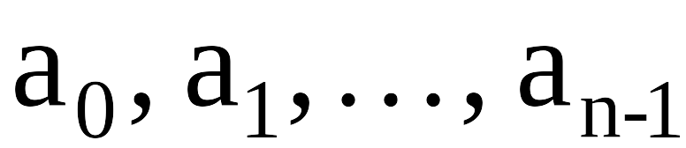
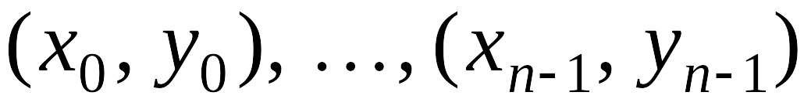
Converting Between Two Polynomial Representations
Tradeoff. Fast evaluation or fast multiplication. We want both!
Goal. Make all ops fast by efficiently converting between two representations.
Representation
Multiply
Evaluate
Coefficient
^{(Time domain)}
O(n²)
O(n)
Point-value
^{(Frequency domain)}
O(n)
O(n²)
coefficient
representation
point-value
representation

Slide 9
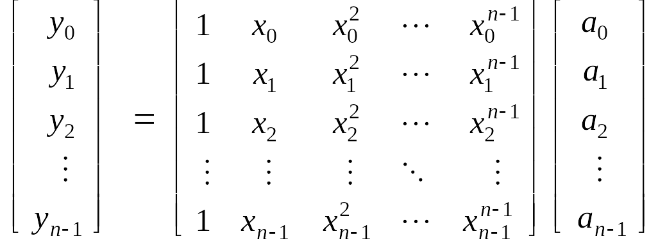
Converting Between Two Polynomial Representations: Brute Force
Coefficient to point-value. Given a polynomial a₀ + a₁ x + ... + a_{n-1} x^{n-1}, evaluate it at n distinct points x₀, ... , x_{n-1}.
Point-value to coefficient. Given n distinct points x₀, ..., x_{n-1} and values y₀, ..., y_{n-1}, find unique polynomial a₀ + a₁ x + ... + a_{n-1} x^{n-1} that has given values at given points.
O(n²) for matrix-vector multiply
O(n³) for Gaussian elimination
Vandermonde matrix is invertible iff x_{i} distinct

Slide 10
Coefficient to Point-Value Representation: Intuition
Coefficient to point-value. Given a polynomial a₀ + a₁ x + ... + a_{n-1} x^{n-1}, evaluate it at n distinct points x₀, ... , x_{n-1}.
Divide. Break polynomial up into even and odd powers.
  A(x) = a₀ + a₁x + a₂x² + a₃x³ + a₄x⁴ + a₅x⁵ + a₆x⁶ + a₇x⁷.
  A_{even}(x) = a₀ + a₂x + a₄x² + a₆x³.
  A_{odd} (x) = a₁ + a₃x + a₅x² + a₇x³.
  A(-x) = A_{even}(x²) + x A_{odd}(x²).
  A(-x) = A_{even}(x²) - x A_{odd}(x²).
Intuition. Choose two points to be ±1.
  A(-1) = A_{even}(1) + 1 A_{odd}(1).
  A(-1) = A_{even}(1) - 1 A_{odd}(1).
Can evaluate polynomial of degree ≤ n
at 2 points by evaluating two polynomials of degree ≤ ½n at 1 point.

Slide 11
Coefficient to Point-Value Representation: Intuition
Coefficient to point-value. Given a polynomial a₀ + a₁ x + ... + a_{n-1} x^{n-1}, evaluate it at n distinct points x₀, ... , x_{n-1}.
Divide. Break polynomial up into even and odd powers.
  A(x) = a₀ + a₁x + a₂x² + a₃x³ + a₄x⁴ + a₅x⁵ + a₆x⁶ + a₇x⁷.
  A_{even}(x) = a₀ + a₂x + a₄x² + a₆x³.
  A_{odd} (x) = a₁ + a₃x + a₅x² + a₇x³.
  A(-x) = A_{even}(x²) + x A_{odd}(x²).
  A(-x) = A_{even}(x²) - x A_{odd}(x²).
Intuition. Choose four points to be ±1, ±i.
  A(-1) = A_{even}(-1) + 1 A_{odd}( 1).
  A(-1) = A_{even}(-1) - 1 A_{odd}(-1).
  A(-i) = A_{even}(-1) + i A_{odd}(-1).
  A(-i) = A_{even}(-1) - i A_{odd}(-1).
Can evaluate polynomial of degree ≤ n
at 4 points by evaluating two polynomials of degree ≤ ½n at 2 points.

Slide 12
Discrete Fourier Transform
Coefficient to point-value. Given a polynomial
P(x) = a₀ + a₁ x + ... + a_{n-1} x^{n-1},
DFTωP(x) maps P(x) to polynomial Q(x) = b₀ + b₁ x + ... + b_{n-1} x^{n-1}
Where
bj = P(ω^{k} ) where ω is principal n^{th} root of unity.

Slide 13
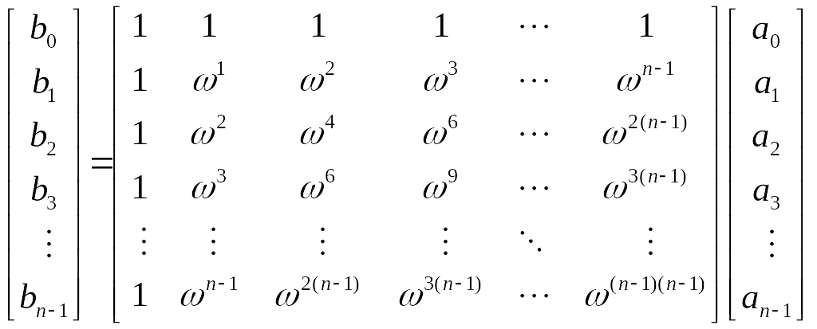
Discrete Fourier Transform
Using coefficient arrays and matrix notions
[a₀, a₁, …., a_{n-1}] mapped to [b₀,b₁,...,b_{n-1}] by
Discrete Fourier transform
Fourier matrix F_{n}

Slide 14
Roots of Unity
Def. An n^{th} root of unity is a complex number x such that x^{n} = 1.
Fact. The n^{th} roots of unity are: ω⁰, ω¹, …, ω^{n-1} where ω = e ^{2π i / n}.
Pf. (ω^{k})^{n} = (e ^{2π i k / n}) ^{n} = (e ^{π i} ) ^{2k} = (-1) ^{2k} = 1.
Fact. The ½n^{th} roots of unity are: ν⁰, ν¹, …, ν^{n/2-1} where ν = e ^{4π i / n}.
Fact. ω² = ν and (ω²)^{k} = ν^{k}.
ω² = ν¹ = i
ω³
ω¹
ω⁴ = ν² = -1
n = 8
ω⁰ = ν⁰ = 1
ω⁵
ω⁷
ω⁶ = ν³ = -i
Notes:
forms a group under multiplication (similar to additive group Z_n modulo n)

Slide 15
Fast Fourier Transform
Goal. Evaluate a degree n-1 polynomial A(x) = a₀ + ... + a_{n-1} x^{n-1} at its n^{th} roots of unity: ω⁰, ω¹, …, ω^{n-1}.
Divide. Break polynomial up into even and odd powers.
  A_{even}(x) = a₀ + a₂x + a₄x² + … + a_{n/2-2} x^{(n-1)/2}.
  A_{odd} (x) = a₁ + a₃x + a₅x² + … + a_{n/2-1} x^{(n-1)/2}.
  A(x) = A_{even}(x²) + x A_{odd}(x²).
Conquer. Evaluate degree A_{even}(x) and A_{odd}(x) at the ½n^{th} roots of unity: ν⁰, ν¹, …, ν^{n/2-1}.
Combine.
  A(ω^{k+n}) = A_{even}(ν^{k}) + ω^{k} A_{odd}(ν^{k}), 0 ≤ k < n/2
  A(ω^{k+n/2}) = A_{even}(ν^{k}) - ω^{k} A_{odd}(ν^{k}), 0 ≤ k < n/2
ν^{k} = (ω^{k})² = (ω^{k+n})²
ω^{k+n/2} = -ω^{k}

Slide 16
FFT Algorithm
FFT(n, a₀,a₁,…,a_{n-1}) {
if (n == 1) return a₀
(e₀,e₁,…,e_{n/2-1}) ← FFT(n/2, a₀,a₂,a₄,…,a_{n-2})
(d₀,d₁,…,d_{n/2-1}) ← FFT(n/2, a₁,a₃,a₅,…,a_{n-1})
for k = 0 to n/2 - 1 {
ω^{k} ← e^{2πik/n}
y_{k+n/2} ← e_{k} + ω^{k} d_{k}
y_{k+n/2} ← e_{k} - ω^{k} d_{k}
}
return (y₀,y₁,…,y_{n-1})
}

Slide 17
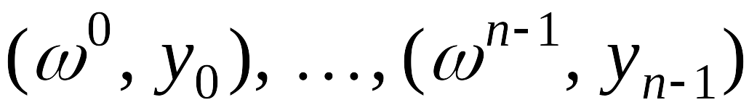
FFT Summary
Theorem. FFT algorithm evaluates a degree n-1 polynomial at each of the n^{th} roots of unity in O(n log n) steps. Assumes n is a power of 2.
Running time. W(n) = 2W(n/2) + n ⇒ W(n) = O(n log n).
O(n log n)
coefficient
representation
point-value
representation

Slide 18
Recursion Tree
a₀, a₁, a₂, a₃, a₄, a₅, a₆, a₇
perfect shuffle
a₀, a₂, a₄, a₆
a₁, a₃, a₅, a₇
a₀, a₄
a₂, a₆
a₁, a₅
a₃, a₇
a₀
a₄
a₂
a₆
a₁
a₅
a₃
a₇
000
100
010
110
001
101
011
111
"bit-reversed" order
Notes:
each recursive call performs a "perfect shuffle"
leaves of tree are in "bit-reversed" order - if you read the bits backwards, it counts from 000 to 111 in binary

Slide 19
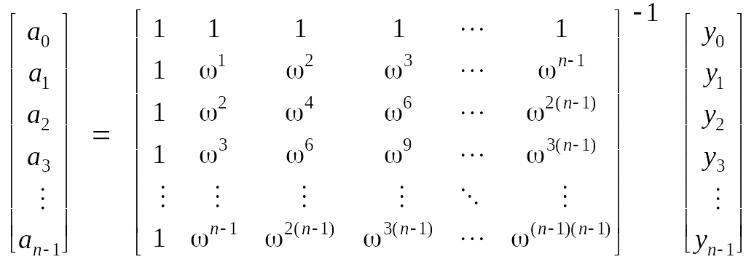
Point-Value to Coefficient Representation: Inverse DFT
Goal. Given the values y₀, ... , y_{n-1} of a degree n-1 polynomial at the n points ω⁰, ω¹, …, ω^{n-1}, find unique polynomial a₀ + a₁ x + ... + a_{n-1} x^{n-1} that has given values at given points.
Inverse DFT
Fourier matrix inverse (F_{n})⁻¹

Slide 20
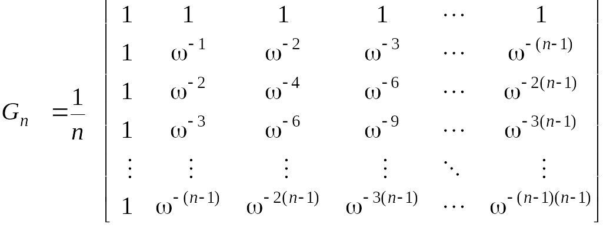
Inverse FFT
Claim. Inverse of Fourier matrix is given by following formula.
Consequence. To compute inverse FFT, apply same algorithm but use ω⁻¹ = e ^{-2π i / n} as principal n^{th} root of unity (and divide by n).

Slide 21
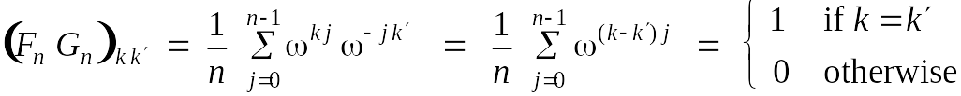
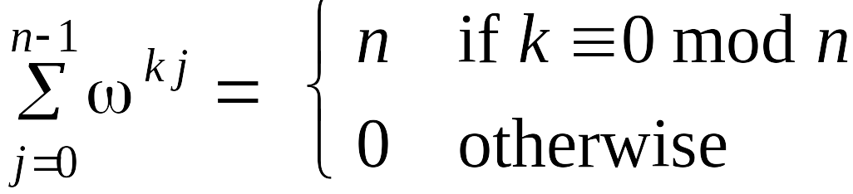
Inverse FFT: Proof of Correctness
Claim. F_{n} and G_{n} are inverses.
Pf.
Summation lemma. Let ω be a principal n^{th} root of unity. Then
Pf.
  If k is a multiple of n then ω^{k} = 1 ⇒ sums to n.
  Each n^{th} root of unity ω^{k} is a root of x^{n} - 1 = (x - 1) (1 + x + x² + ... + x^{n-1}).
  if ω^{k} ≠ 1 we have: 1 + ω^{k} + ω^{k(2)} + . . . + ω^{k(n-1)} = 0 ⇒ sums to 0. ▪
summation lemma

Slide 22
Inverse FFT: Algorithm
ifft(n, a₀,a₁,…,a_{n-1}) {
if (n == 1) return a₀
(e₀,e₁,…,e_{n/2-1}) ← FFT(n/2, a₀,a₂,a₄,…,a_{n-2})
(d₀,d₁,…,d_{n/2-1}) ← FFT(n/2, a₁,a₃,a₅,…,a_{n-1})
for k = 0 to n/2 - 1 {
ω^{k} ← e^{-2πik/n}
y_{k+n/2} ← (e_{k} + ω^{k} d_{k}) / n
y_{k+n/2} ← (e_{k} - ω^{k} d_{k}) / n
}
return (y₀,y₁,…,y_{n-1})
}

Slide 23
Inverse FFT Summary
Theorem. Inverse FFT algorithm interpolates a degree n-1 polynomial given values at each of the n^{th} roots of unity in O(n log n) steps.
assumes n is a power of 2
O(n log n)
coefficient
representation
O(n log n)
point-value
representation

Slide 24
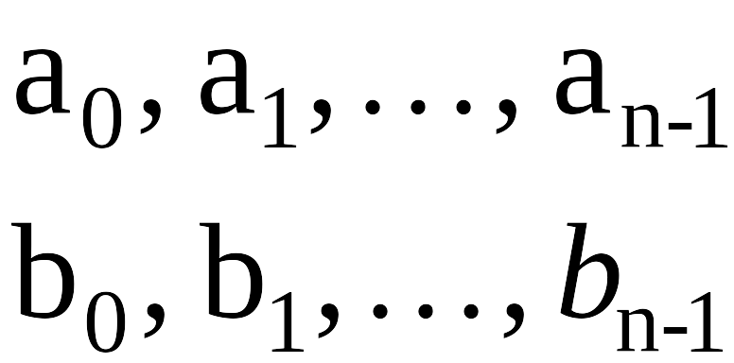
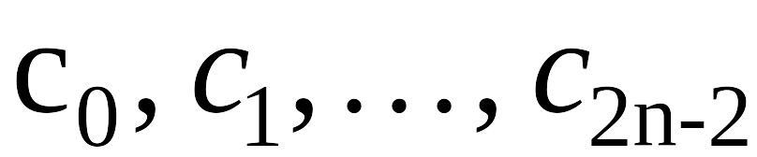
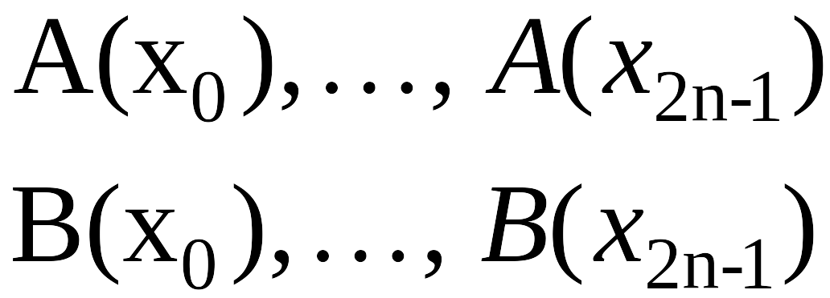
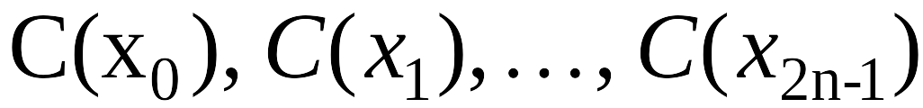
Polynomial Multiplication
Theorem. Can multiply two degree n-1 polynomials in O(n log n) steps.
coefficient
representation
coefficient
representation
FFT
O(n log n)
inverse FFT
O(n log n)
point-value multiplication
O(n)

Slide 25
FFT in Practice
Fastest Fourier transform in the West. [Frigo and Johnson]
  Optimized C library.
  Features: DFT, DCT, real, complex, any size, any dimension.
  Won 1999 Wilkinson Prize for Numerical Software.
  Portable, competitive with vendor-tuned code.
Implementation details.
  Instead of executing predetermined algorithm, it evaluates your hardware and uses a special-purpose compiler to generate an optimized algorithm catered to "shape" of the problem.
  Core algorithm is nonrecursive version of Cooley-Tukey radix 2 FFT.
  O(n log n), even for prime sizes.
Reference: http://www.fftw.org

Slide 26
Integer Multiplication
Integer multiplication. Given two n bit integers a = a_{n-1} … a₁a₀ and
b = b_{n-1} … b₁b₀, compute their product c = a × b.
Convolution algorithm.
  Form two polynomials.
  Note: a = A(2), b = B(2).
  Compute C(x) = A(x) × B(x).
  Evaluate C(2) = a × b.
  Running time: O(n log n) complex arithmetic steps.
Theory. [Schönhage-Strassen 1971] O(n log n log log n) bit operations.
Practice. [GNU Multiple Precision Arithmetic Library] GMP proclaims to be "the fastest bignum library on the planet." It uses brute force, Karatsuba, and FFT, depending on the size of n.

